Slide 1
Green Bus Ticketing System
Supervisor: Kiều Trọng Khánh
Members:
Đỗ Ngọc Hoàng - SE61246 – Team Leader
Trần Quang Trường – SE61129
Đoàn Minh Đức - SE61486

Slide 2
Overview
Scenarios Problems
Current Solution
Team’s Solution
Feature explanations and Demo
Advantages and Disadvantages
Future Plan

Slide 3

Introduction
Notes:
1. Tiết kiệm chi phí
2. Giảm ùn tắc giao thông
3. Hạn chế căng thẳng
4. Hạn chế được các tác động thời tiết bên ngoài
5. Có nhiều thời gian trò chuyện cùng bạn bè hơn

Slide 4

Introduction

Slide 5




1. Scenario Problems
Student A takes a bus to school.
FPT-University
Student A

Slide 6


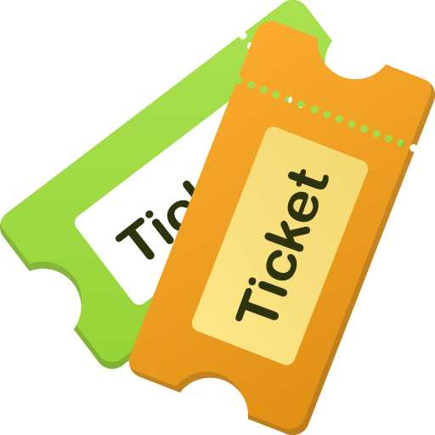
1. Buy Ticket
Staff B
Student A
Notes:
Đi xe buýt mua vé trực tiếp
Lên xe
Mua vé từ nhân viên
Nhận vé từ nhân viên (có thế nhận tiền thừa)
=> Mất thời gian không hiệu quả và chủ động

Slide 7
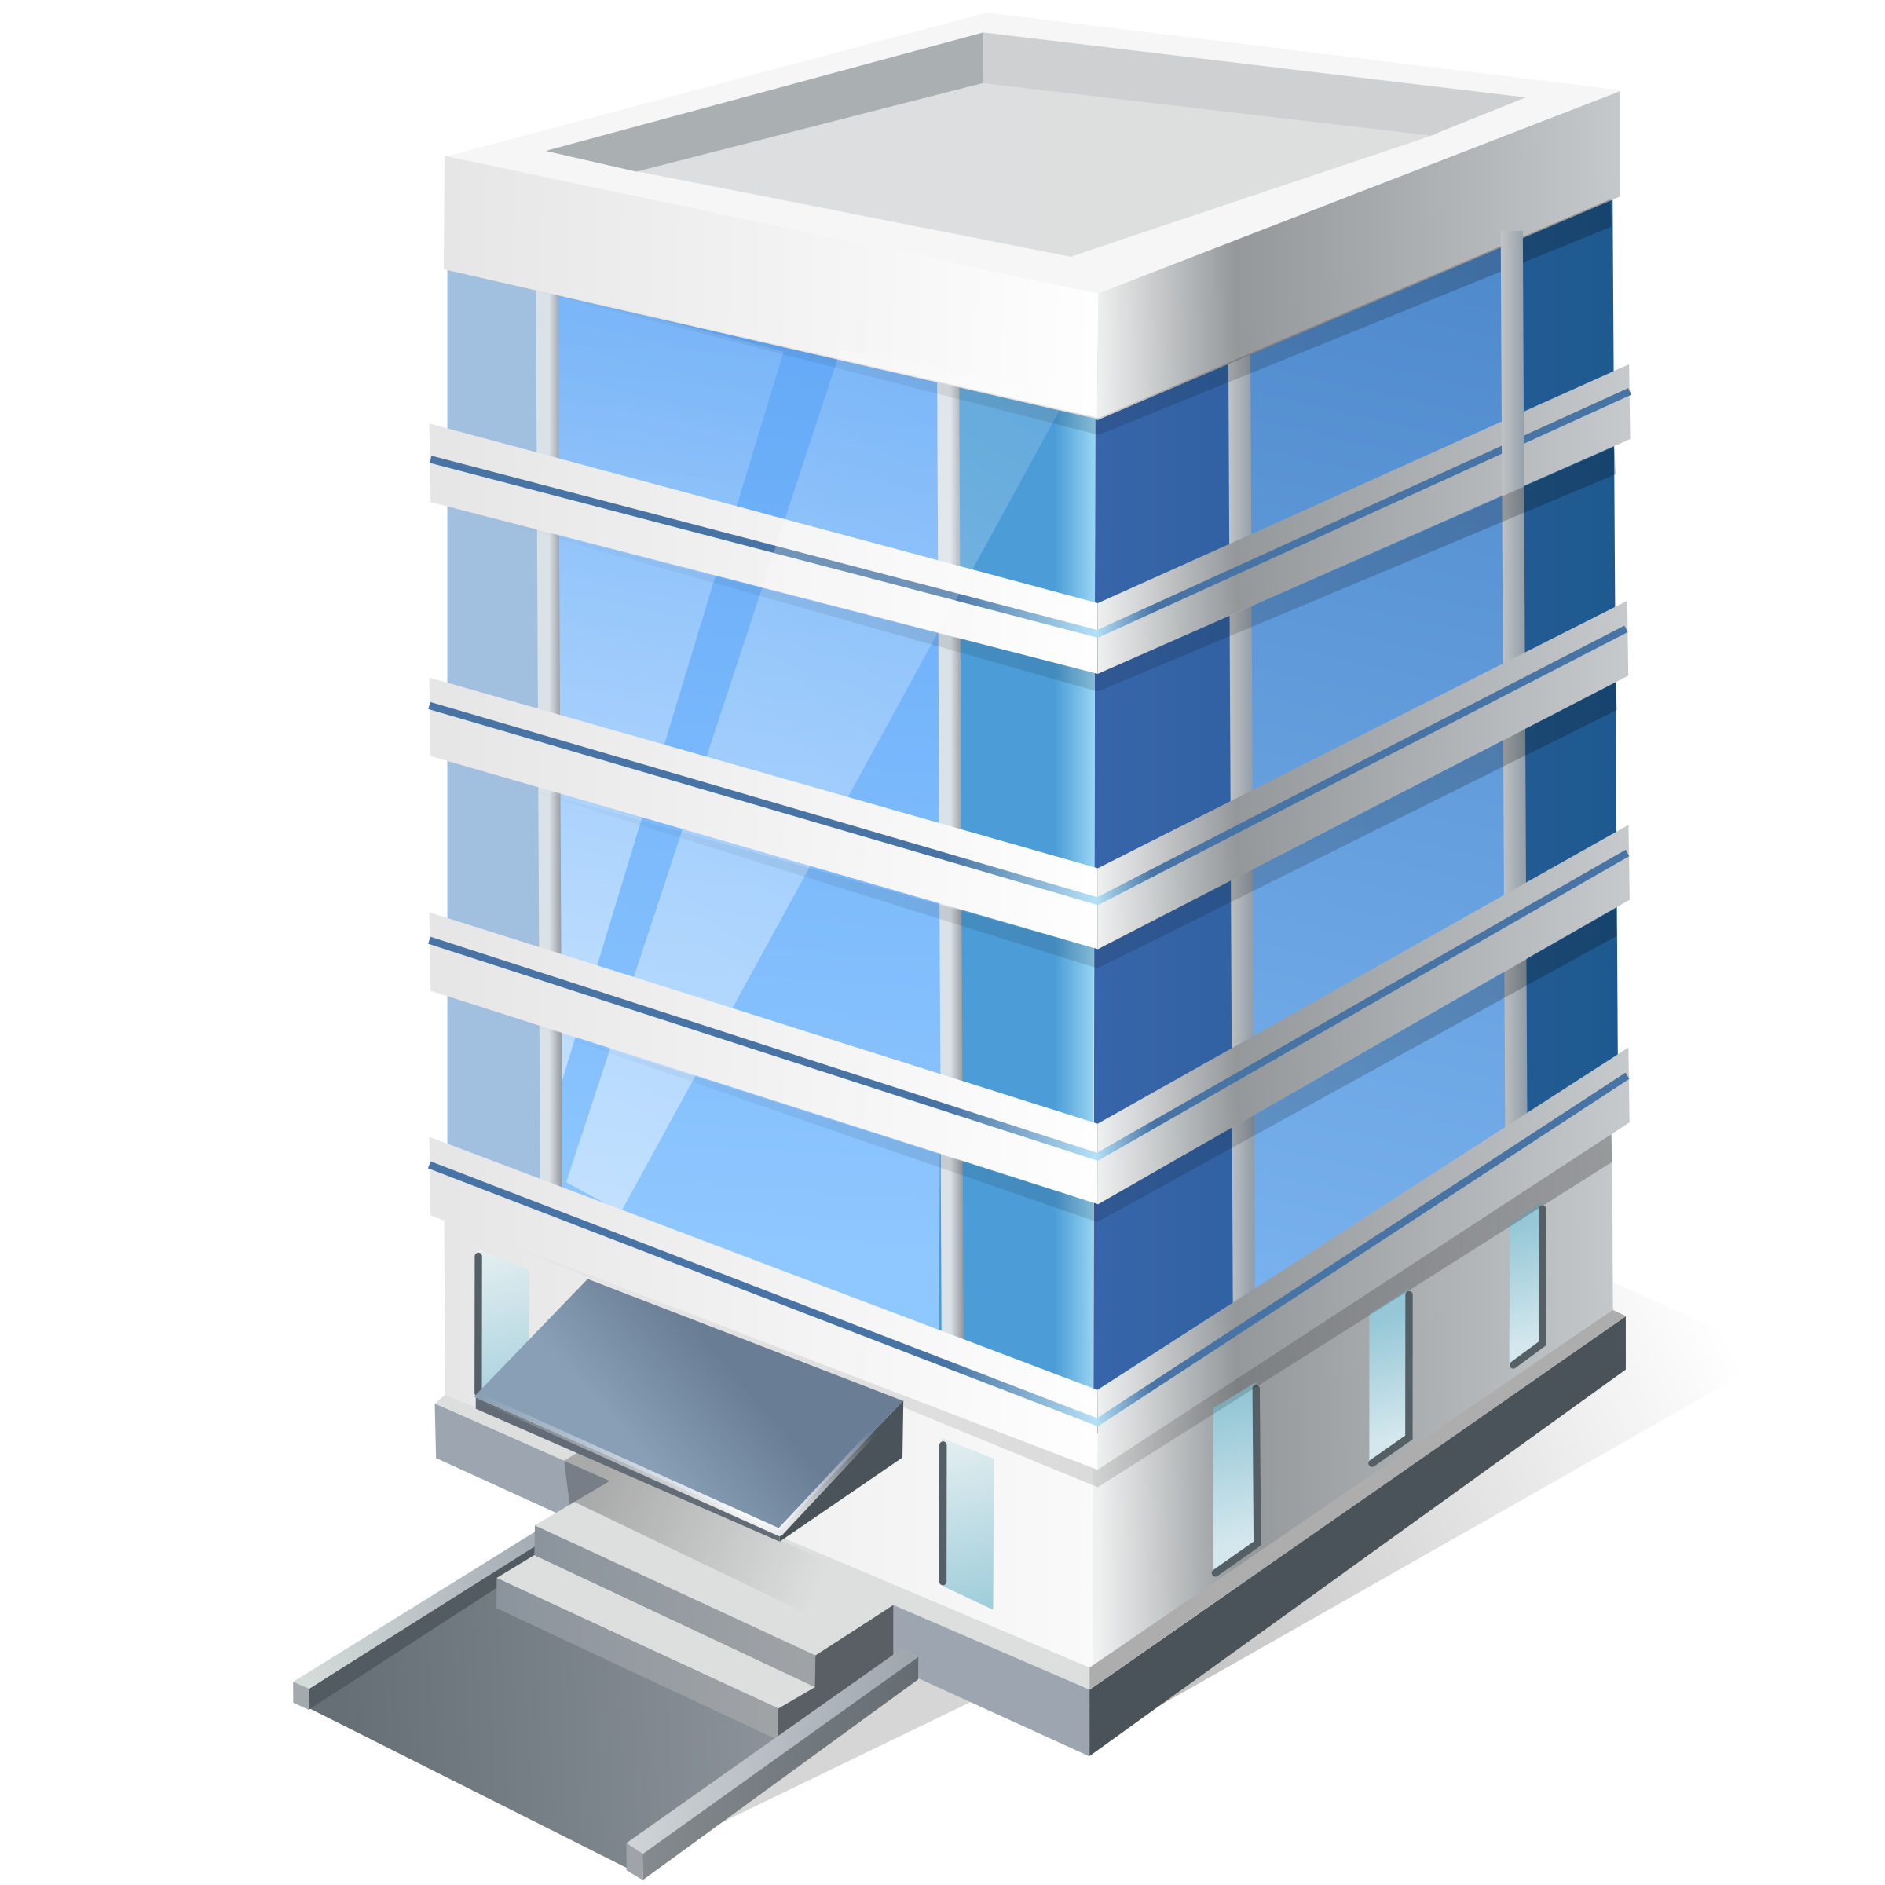


2. Monthly Ticket
Bus Station / Office
Bus Station / Office
Staff B
Student A
Notes:
Sử dụng vé tháng
Muốn có vé tháng
Đến trụ sở hoặc bến xe để mua
Nhận 1 tập vé từ nhân viên
Lên xe buýt
Đưa vé tháng cho nhân viên
Nhận lại 1 vé xác nhận
=>

Slide 8
Current Problem

Slide 9
1. Buy Ticket
Bus Station / Office
Staff B
Student A

Slide 10
Hello!
I am Jayden Smith
I am here because I love to give presentations.
You can find me at @username

Slide 11
Transition headline
Let’s start with the first set of slides

Slide 12
Quotations are commonly printed as a means of inspiration and to invoke philosophical thoughts from the reader.

Slide 13
This is a slide title
Here you have a list of items
And some text
But remember not to overload your slides with content
You audience will listen to you or read the content, but won’t do both.

Slide 14
BIG CONCEPT
Bring the attention of your audience over a key concept using icons or illustrations

Slide 15
You can also split your content
White
Is the color of milk and fresh snow, the color produced by the combination of all the colors of the visible spectrum.
Black
Is the color of coal, ebony, and of outer space. It is the darkest color, the result of the absence of or complete absorption of light.

Slide 16
In two or three columns
Yellow
Is the color of gold, butter and ripe lemons. In the spectrum of visible light, yellow is found between green and orange.
Blue
Is the colour of the clear sky and the deep sea. It is located between violet and green on the optical spectrum.
Red
Is the color of blood, and because of this it has historically been associated with sacrifice, danger and courage.

Slide 17
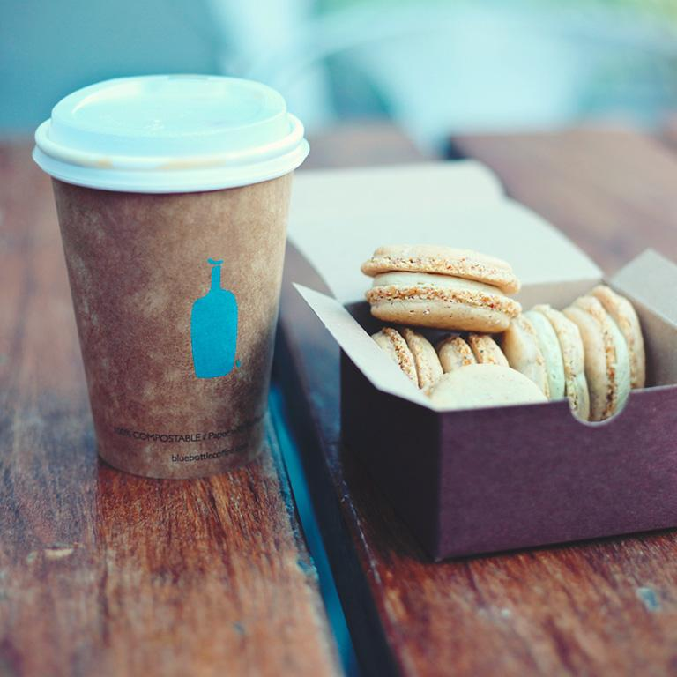
A picture is worth a thousand words
A complex idea can be conveyed with just a single still image, namely making it possible to absorb large amounts of data quickly.

Slide 18
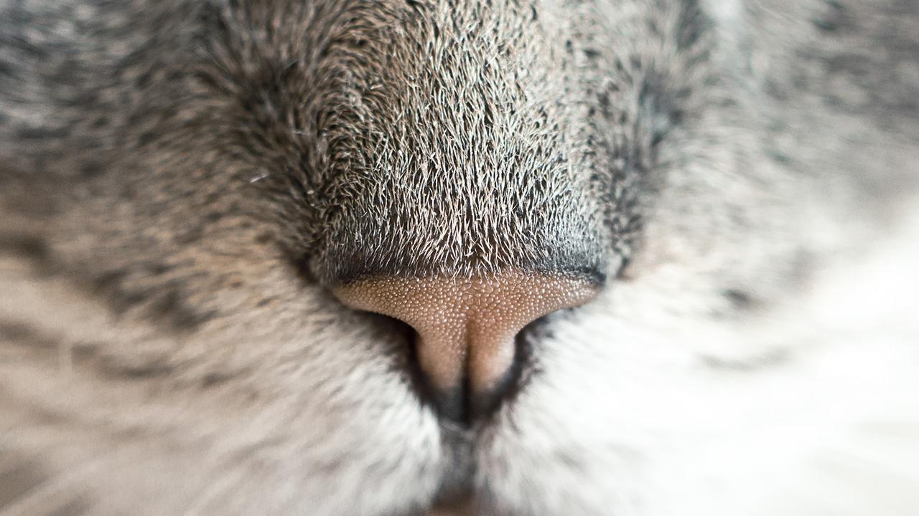
Want big impact? Use big image.

Slide 19
Use charts to explain your ideas
Gray
White
Black

Slide 20
And tables to compare data
 | A | B | C
Yellow | 10 | 20 | 7
Blue | 30 | 15 | 10
Orange | 5 | 24 | 16

Slide 21
Maps
our office

Slide 22
89,526,124
Whoa! That’s a big number, aren’t you proud?

Slide 23
89,526,124$
185,244 users
100%
That’s a lot of money
And a lot of users
Total success!

Slide 24
Our process is easy
first
last
second

Slide 25
Let’s review some concepts
Yellow
Is the color of gold, butter and ripe lemons. In the spectrum of visible light, yellow is found between green and orange.
Blue
Is the colour of the clear sky and the deep sea. It is located between violet and green on the optical spectrum.
Red
Is the color of blood, and because of this it has historically been associated with sacrifice, danger and courage.
Yellow
Is the color of gold, butter and ripe lemons. In the spectrum of visible light, yellow is found between green and orange.
Blue
Is the colour of the clear sky and the deep sea. It is located between violet and green on the optical spectrum.
Red
Is the color of blood, and because of this it has historically been associated with sacrifice, danger and courage.

Slide 26
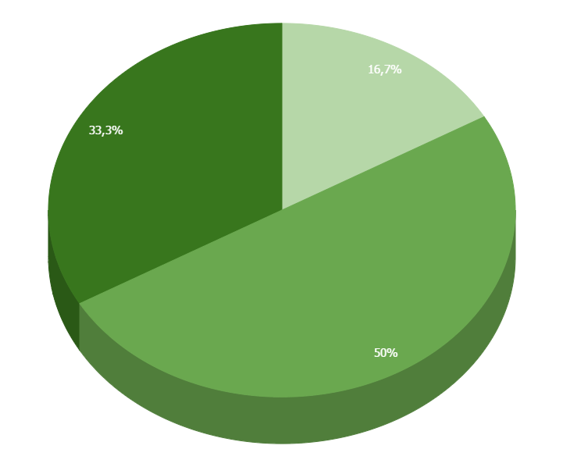
You can copy&paste graphs from Google Sheets

Slide 27
ANDROID PROJECT
Show and explain your web, app or software projects using these gadget templates.
Place your screenshot here

Slide 28
iPHONE
PROJECT
Show and explain your web, app or software projects using these gadget templates.
Place your screenshot here

Slide 29
TABLET PROJECT
Show and explain your web, app or software projects using these gadget templates.
Place your screenshot here

Slide 30
Place your screenshot here
DESKTOP PROJECT
Show and explain your web, app or software projects using these gadget templates.

Slide 31
Thanks!
Any questions?
You can find me at
@username & user@mail.me

Slide 32
Credits
Special thanks to all the people who made and released these awesome resources for free:
Presentation template by SlidesCarnival
Photographs by Unsplash

Slide 33
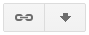
Presentation design
This presentation uses the following typographies and colors:
Titles: Varela Round
Body copy: Varela Round
You can download the fonts on this page:
https://www.google.com/fonts#UsePlace:use/Collection:Varela+Round
Click on the “arrow button” that appears on the top right
Bright green #7bd100
Gray #546973
You don’t need to keep this slide in your presentation. It’s only here to serve you as a design guide if you need to create new slides or download the fonts to edit the presentation in PowerPoint®

Slide 34
SlidesCarnival icons are editable shapes.
This means that you can:
Resize them without losing quality.
Change fill color and opacity.
Change line color, width and style.
Isn’t that nice? :)
Examples:

Slide 35
😉
Now you can use any emoji as an icon!
And of course it resizes without losing quality and you can change the color.
How? Follow Google instructions https://twitter.com/googledocs/status/730087240156643328
✋👆👉👍👤👦👧👨👩👪💃🏃💑❤😂😉😋😒😭👶😸🐟🍒🍔💣📌📖🔨🎃🎈🎨🏈🏰🌏🔌🔑 and many more...

